Slide 1

Houshold Incomes Prediction
Falomy Eugene
This Photo by Unknown author is licensed under CC BY-SA-NC.
Notes:
- Say names
- move to the next slides to introduce the project.

Slide 2
Agenda
A quick recap of the solution, and additional supporting details
What do we know from a statistical perspective?
Data & Insights
Recap
Introduction
Recommendation
A quick overview & summary of team’s methods, result, goals.
What is the next step for the company? And why?
Notes:
- today we will be presenting our findings related to whether household incomes greater than $50k can be predicted.
- we will be assessing how variables such as age, marital-status, sex, gender, ect.. affect level of income.
- We are using the Census Income Dataset.
- we will be giving recommendations about the marketing campaign as to which specific niche the campaign should target

Slide 3
Executive Summary
Business Questions: Can household incomes greater than $50k be predicted ?
Goal: Given that a study suggests that household with income higher than $50k have response rate that is profitable to the bank, those household with certain characteristics / features would be the target(s) of a $25 Million marketing campaign.
Take away (based on the Logistic Model)
Work Class, Occupation, Education, Marital Status, Age, and Sex are best indicators to predict incomes higher than $50K
People with higher education and stable relationship tend to have income greater than $50k.
In the high-income group, the percentage of male is way higher than the percentage of female.

Slide 4
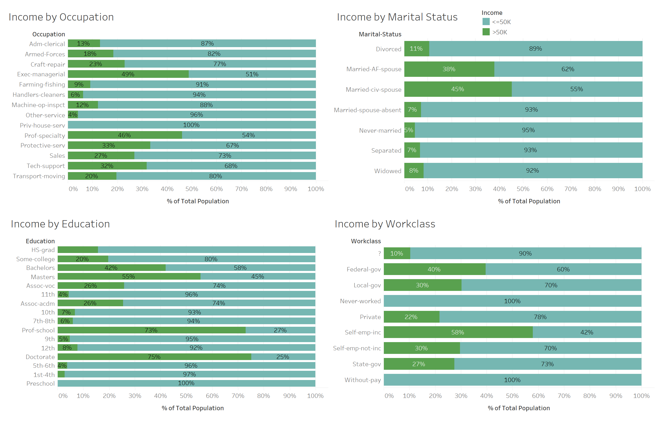
Insights #1
Occupation / Work Class
Marital Status
Education
Notes:
Overall there are more people who are making less than 50k a year. If we are looking the graphics on the right side, the difference among certain groups over another are significant. People with specific job title and advance education background tend to have a high income compare to other groups.

Slide 5
Takeaway
Work & Occupation have strong impact on the salary & income. People with a job in education & Government sector or who are self-employed tend to have the highest income among all the people
Education background & marital status also positively affect the income level. People with advance educational background & in a stable relationship tend to have a higher income in the group.
Notes:
Work & Occupation have strong impact on the salary & income. People with a job in education & Government sector or who are self-employed tend to have the highest income among all the people
Education background & marital status also positively affect the income level. People with advance educational background & in a stable relationship tend to have a higher income in the group.

Slide 6
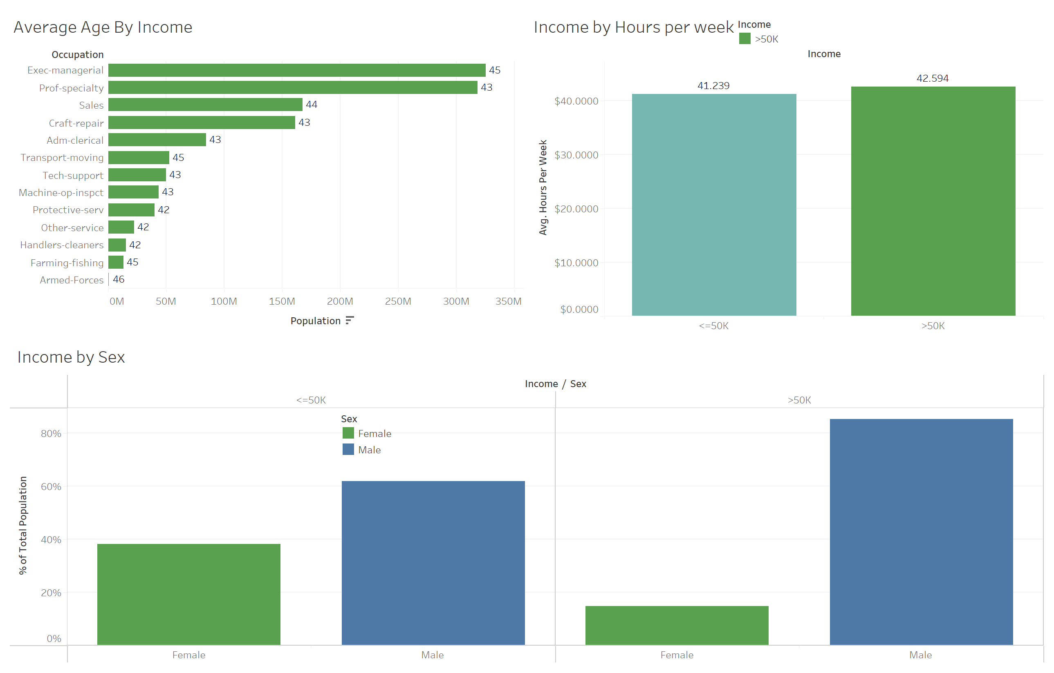
Insights #2
Hours per week
Age
Sex
Notes:
If you are looking at the graphics on the right side. There are no significant differences among people with different age and different work hour. Occupation seems a strong indicator for high income.
There seems to be a higher population of male in the high-income group but similar results can be interpreted from the low income group.

Slide 7
Takeaway
Compared to other indicators, age & work hour don't have significant impact on the income level. They should not be used as indicators to predict income.
Even though there are more males in the high-income group, there are also more male in the low-income group. The male group in general has a higher population in general and should be the focuses of the marketing campaign message.

Slide 8
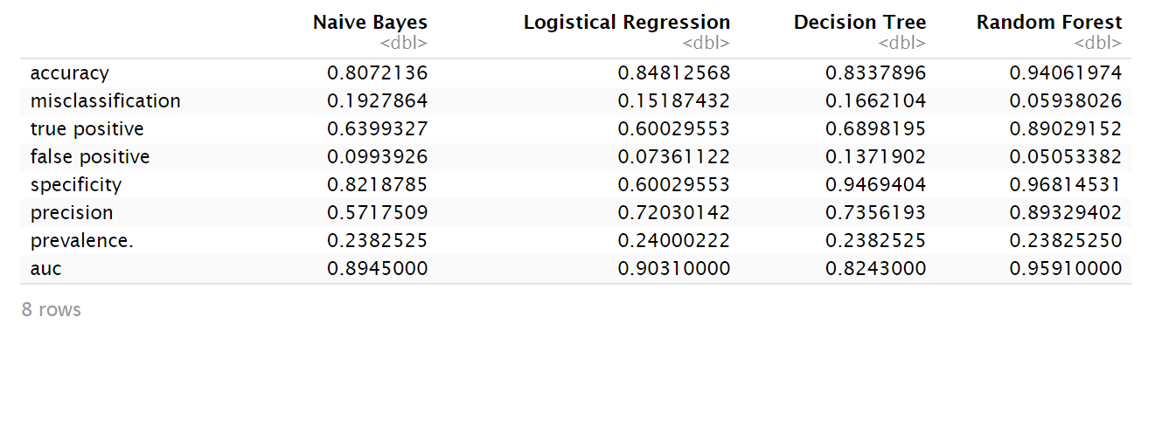
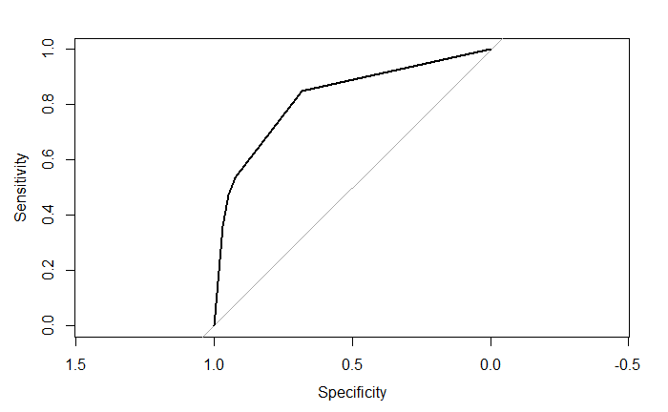
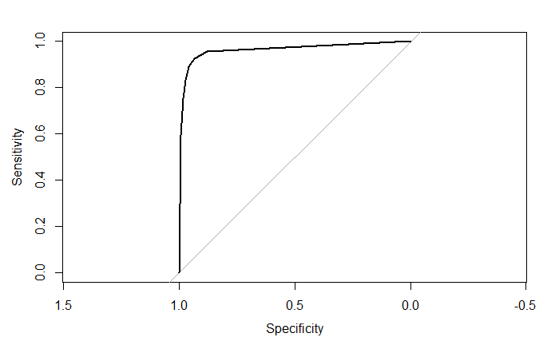
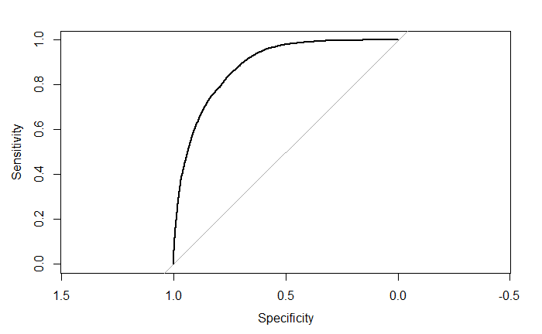
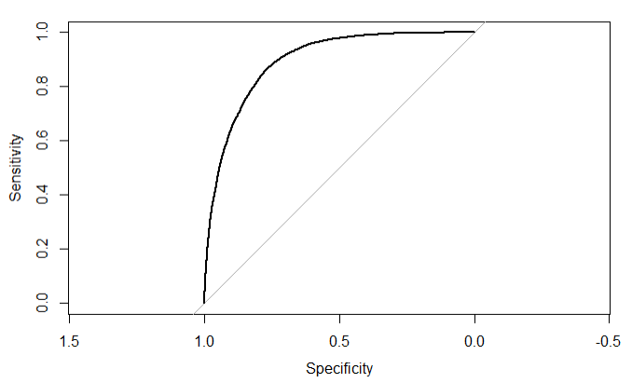
Predictive Model Comparison
The team was able to utilize different methods to generate predictive models.
Based on the accuracy, the team decided to choose the random forest model for future prediction.
However, the logistical regression method can be a reasonable alternative consider its accuracy.
Decision Tree
Random Forest
Naïve Bayes Model
Logistical Regression

Slide 9
Take Away and Recommendation
1. The bank should be targeting people with advanced education background and stable relationship (in a marriage) .
2. People in their late 30 – mid 40 with certain job titles (executives, self-employed, educational worker etc.) should also be targeted.
3. The campaign should also focus on the male population consider their strong presence in the high income work class.

Slide 10
Thank you

Slide 11
Appendix

Slide 12

Data Cleaning/Process- ( Appendix)
Converted Educaioon_num to Categorical
Computedted and showed a tally of outliers on the numeric variables : Age, Capital_gain, Capital_loss, Hours_per_ week
What you do with the outliers?
Removed education_num from the data (same as Education)
Remove both Capital_gain, Capital_loss, bring no value to our analysis
Notes:
- We found out that education_num was supposed to be a categorical variable, so we converted it into categorical in prep for the model
- Given the final weight column in the data was a multiplier, so we rescaled the final weight by 10000, and expanded into the data. Thus, instead of 6 billion data points, we ended up with 601547 observations.
- we computed the tally for outliers on the numeric variables, we age,
-

Slide 13
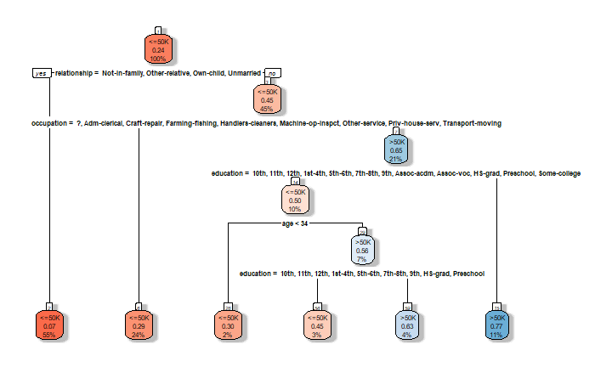
Decision tree model

Slide 14
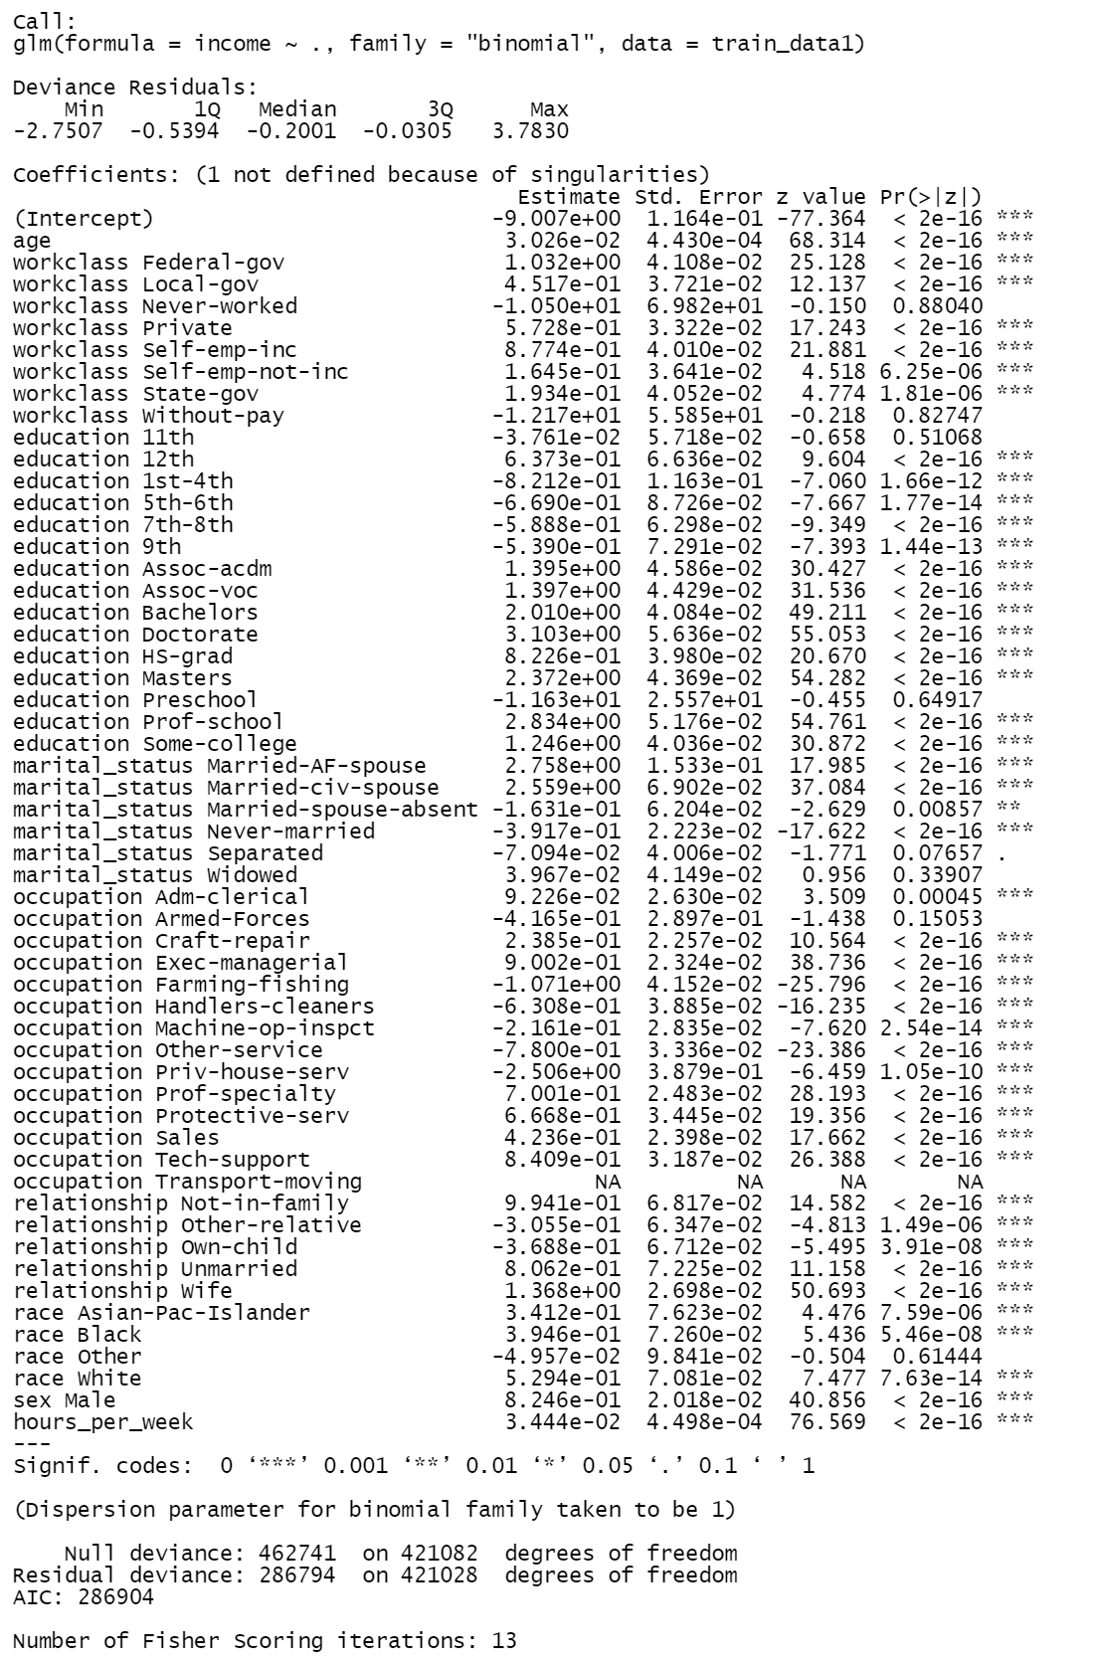
Logit Model

Slide 15
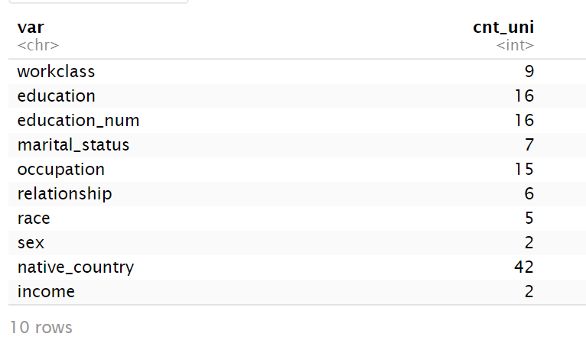
Count Unique categorical variables

Slide 16
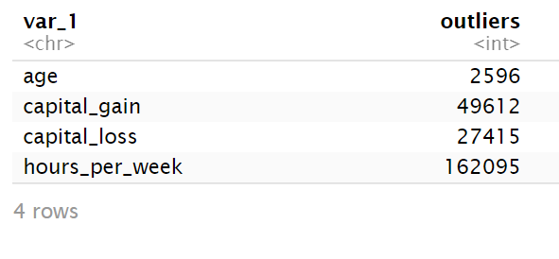
Outlier Count

